Slide 1
TMC INTEGRATION
Talend Tech Solutions
1

Slide 2
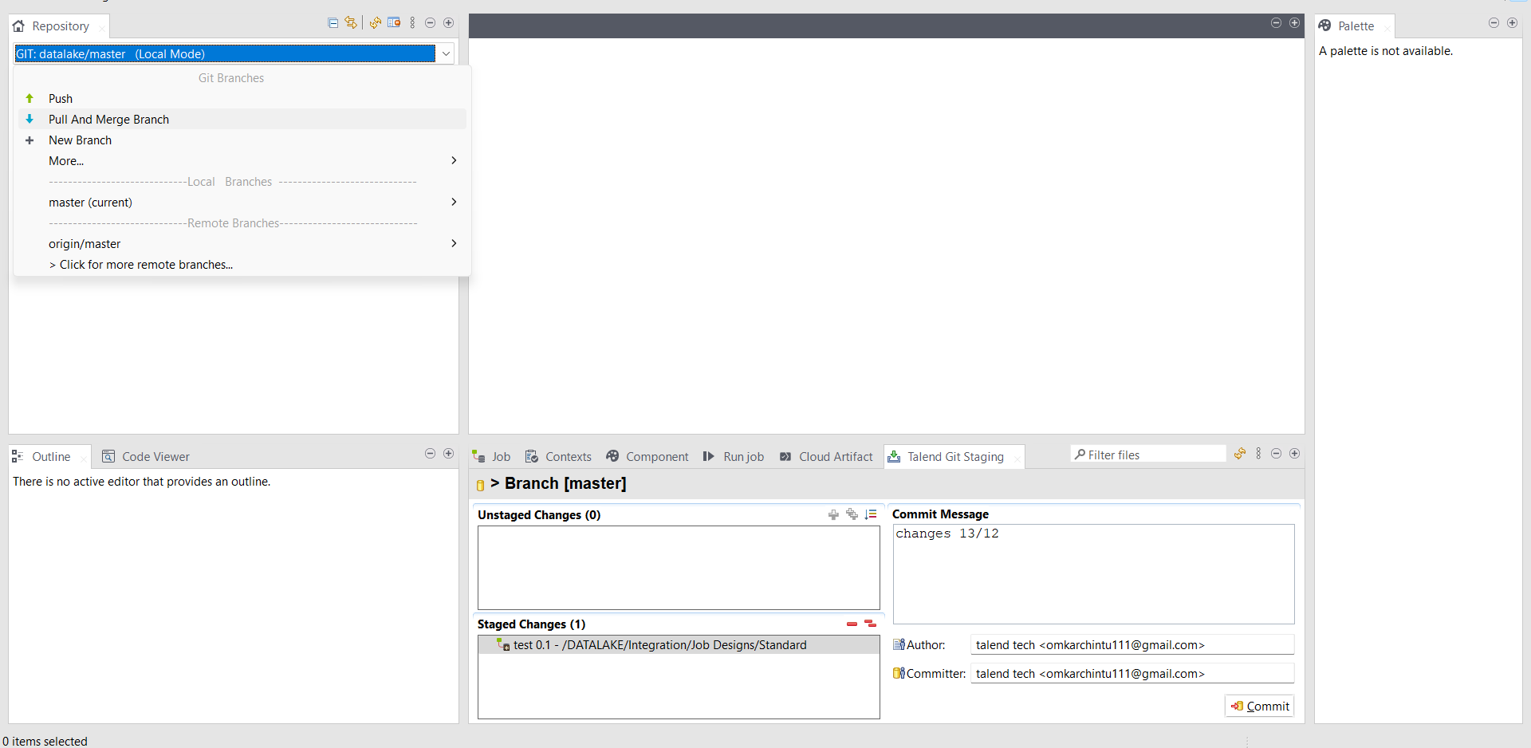
STEP 1 Select Pull and merge
Talend Tech Solutions

Slide 3
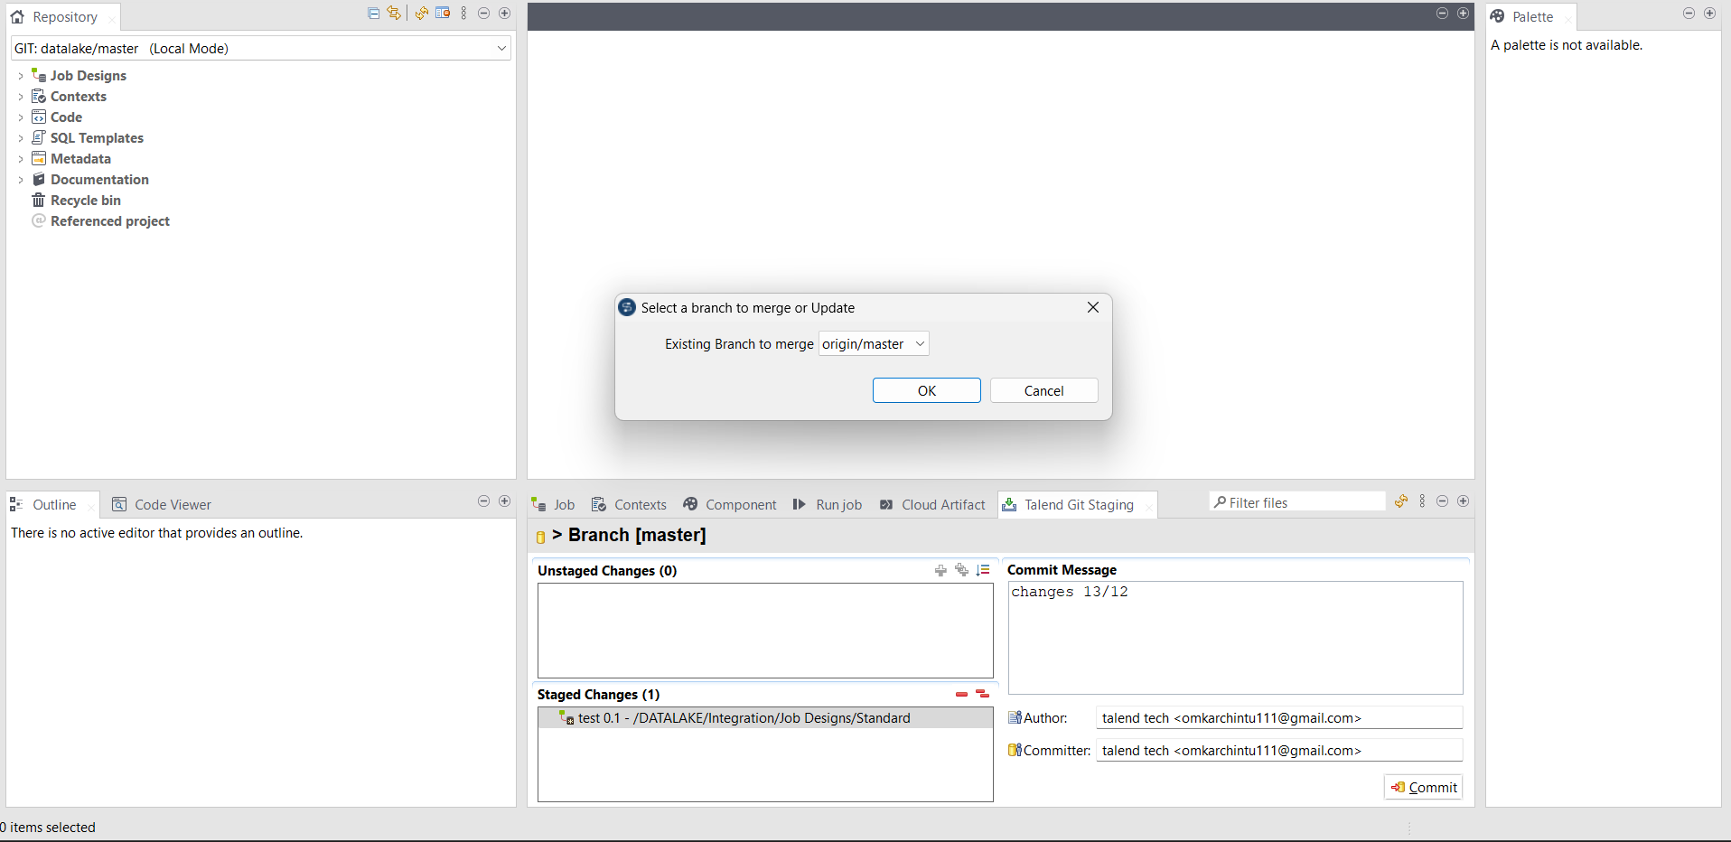
STEP 2 Select branch to merge and ok
STEP 2

Slide 4
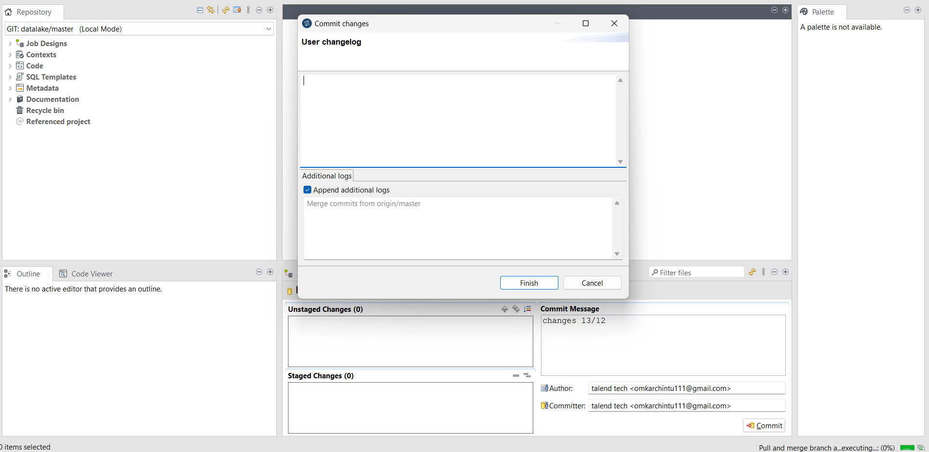
STEP 3 Click on finish
Talend Tech Solutions

Slide 5
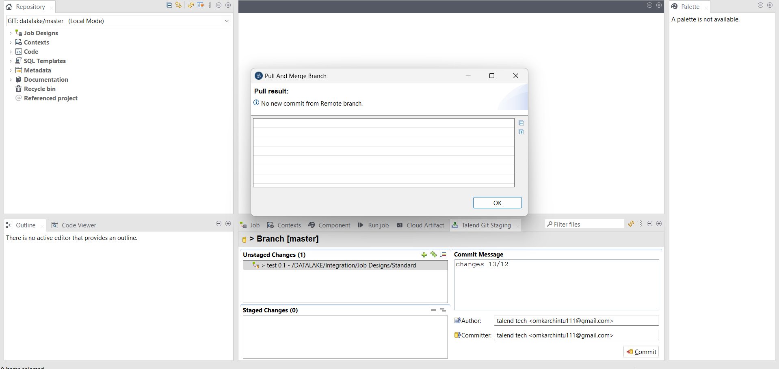
STEP 4 No commits and ok
Talend Tech Solutions

Slide 6
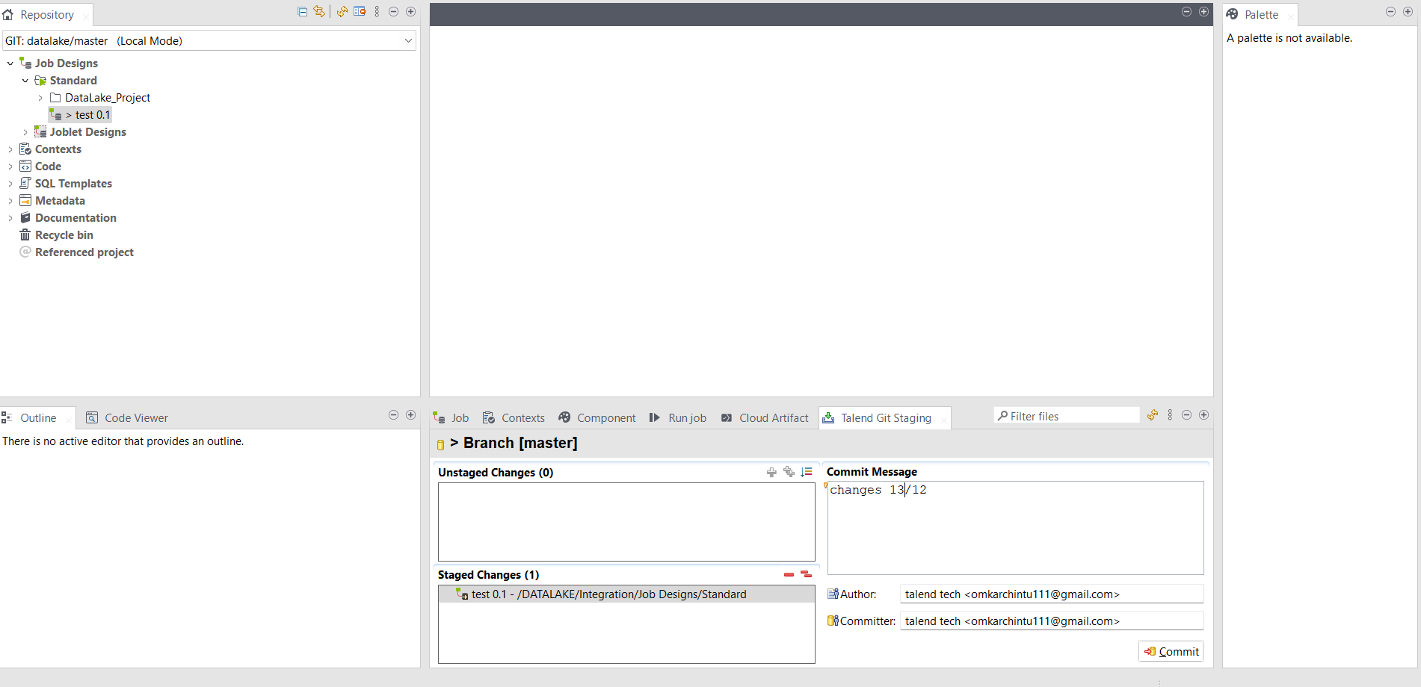
STEP 5 Steps after Development Commit
Talend Tech Solutions

Slide 7
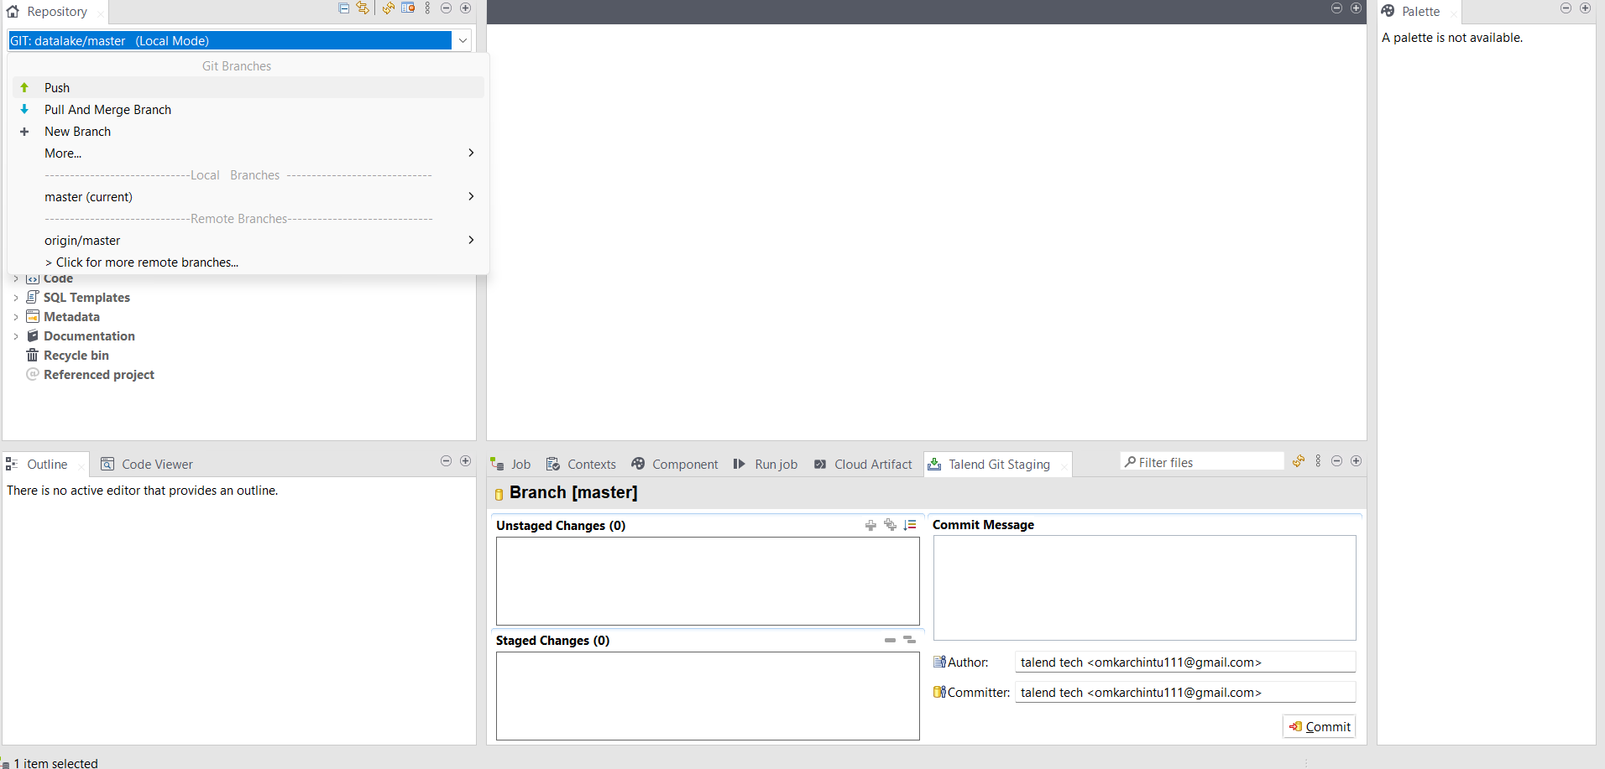
STEP 6 Push
Talend Tech Solutions

Slide 8
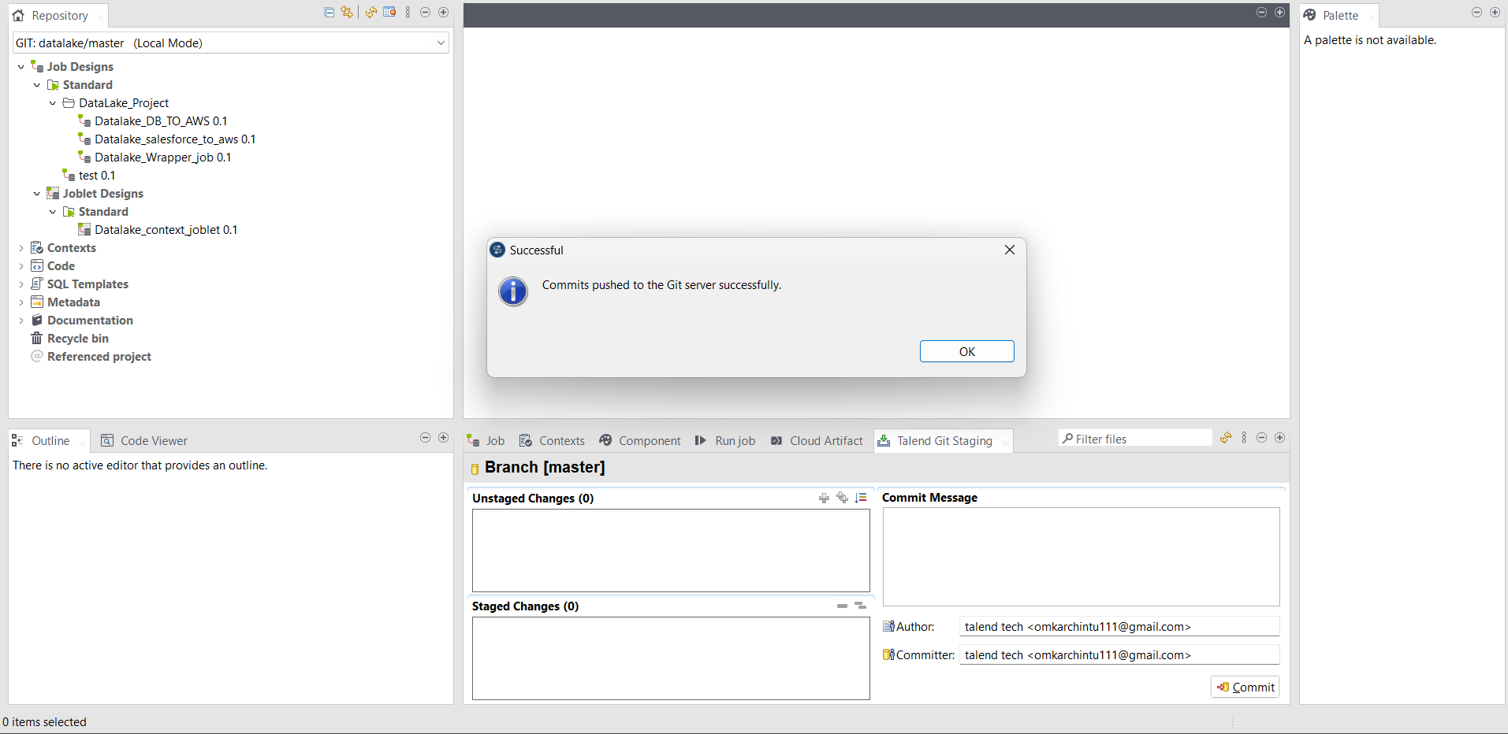
STEP 7 Git success
Talend Tech Solutions

Slide 9
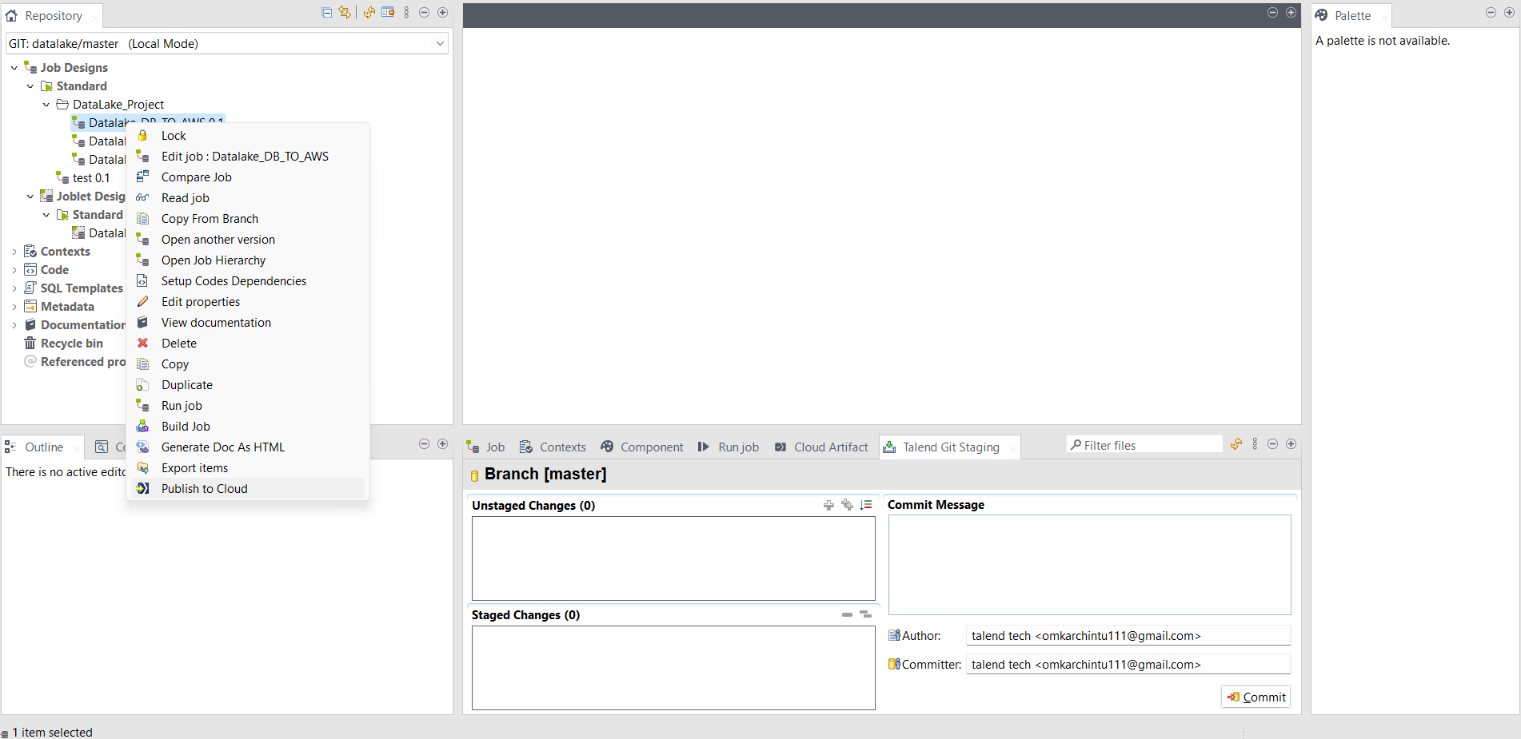
STEP 8 Publish to cloud
Talend Tech Solutions

Slide 10
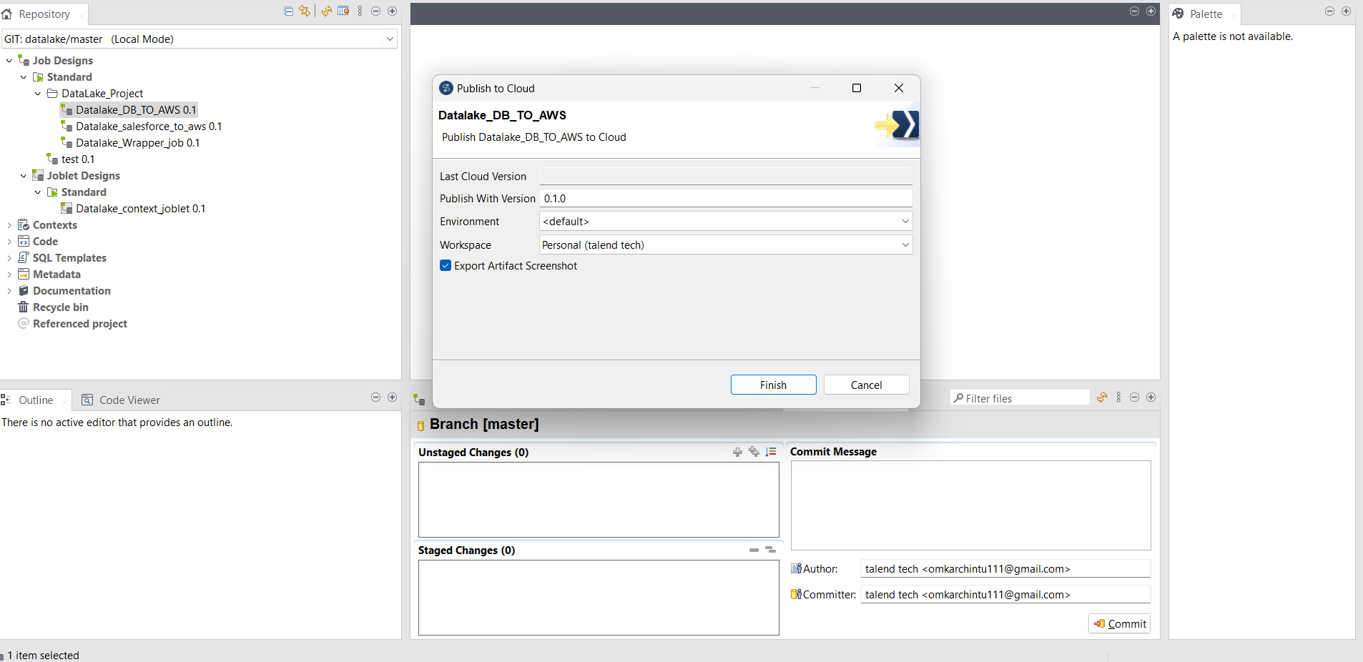
STEP 9 Select environment and workspace
Talend Tech Solutions

Slide 11
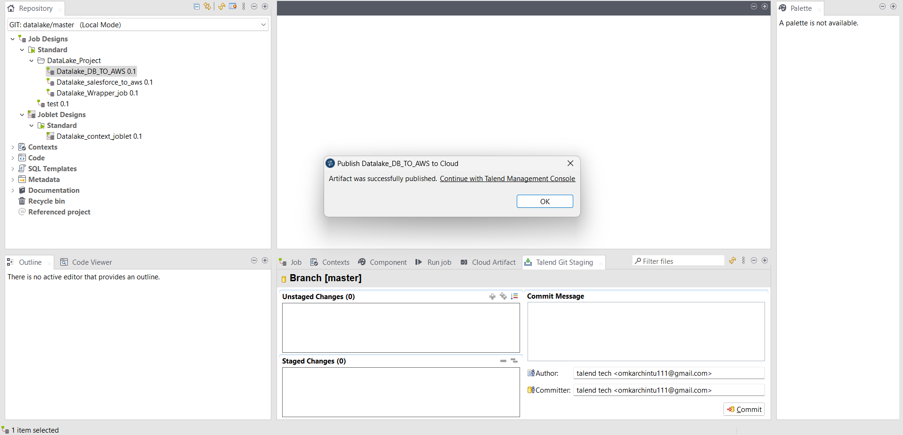
STEP 10 Publish success
Talend Tech Solutions

Slide 12
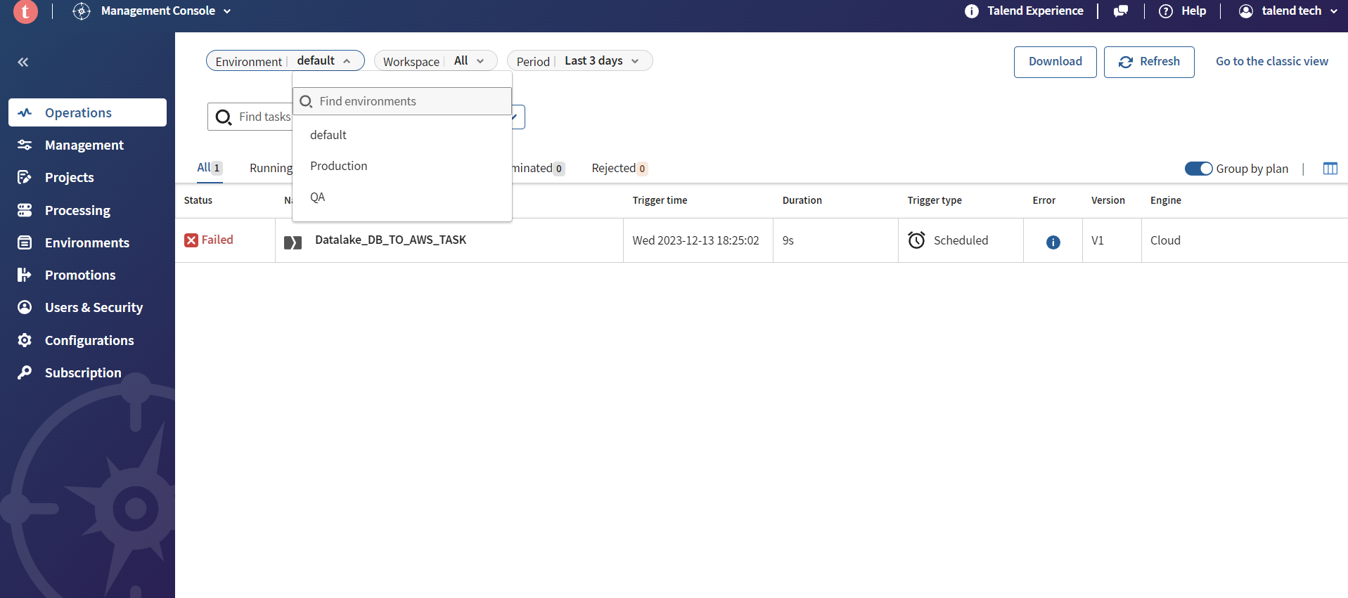
STEP 12 Artifacts
Talend Tech Solutions

Slide 13
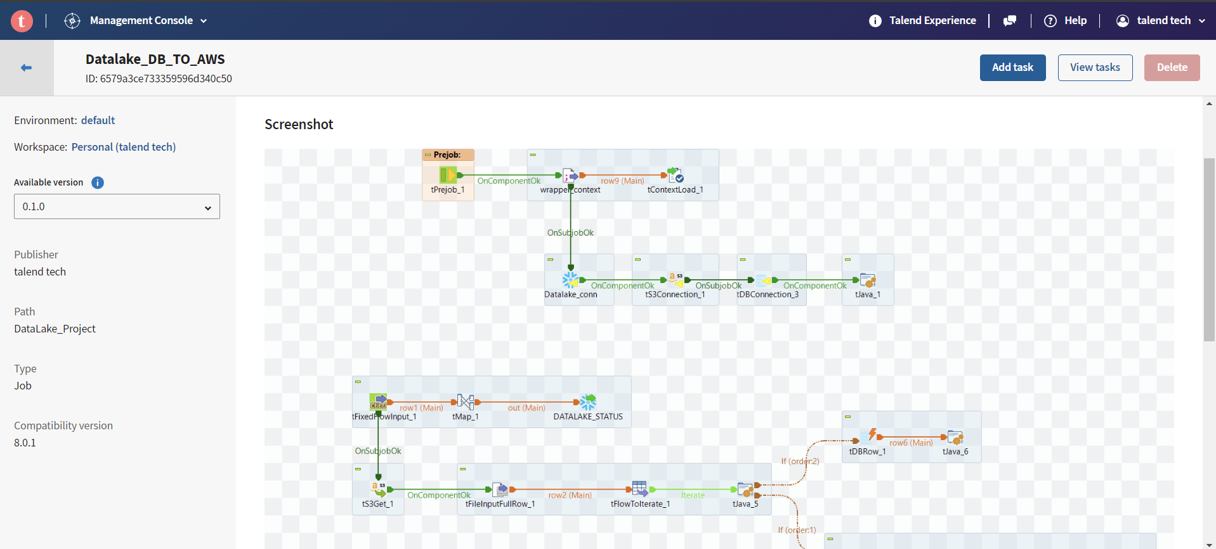
STEP 13 Task
Talend Tech Solutions

Slide 14
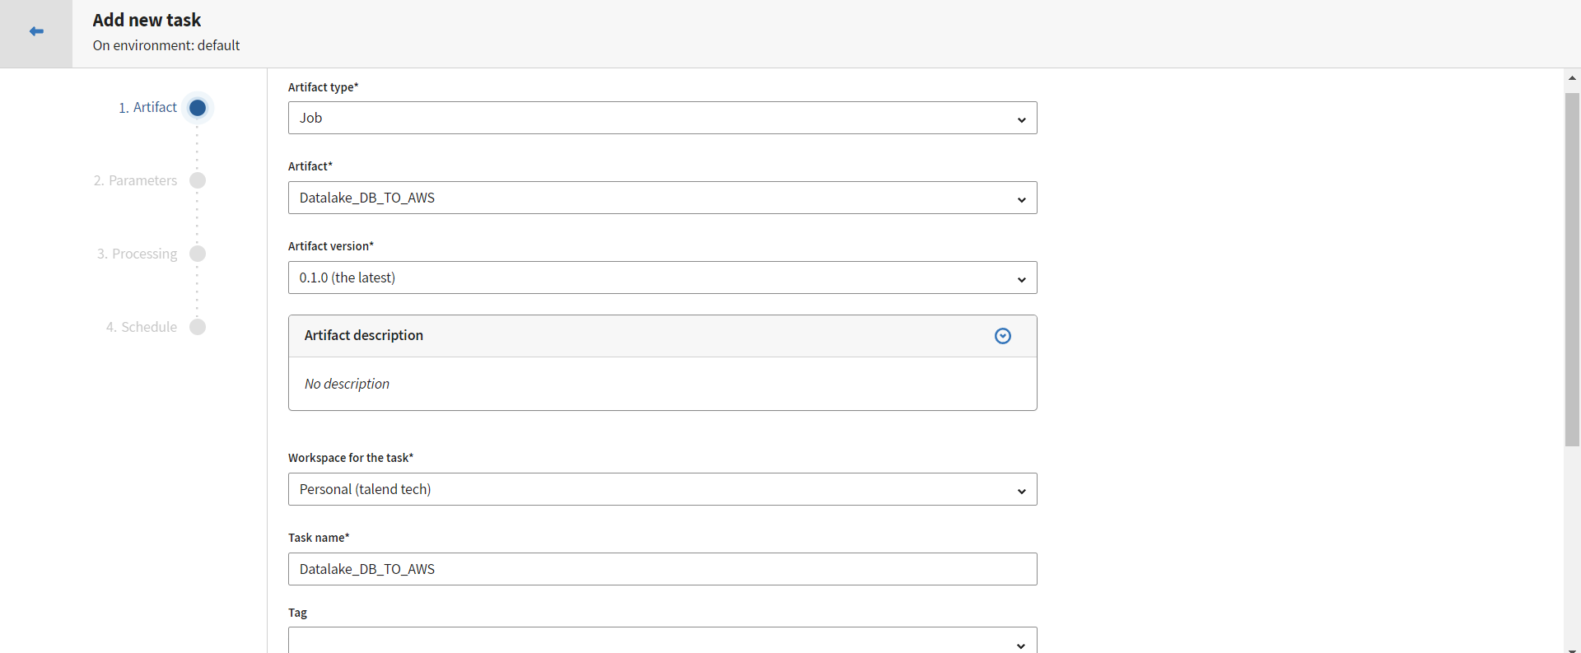
STEP 14 Configurations and click on continue
Talend Tech Solutions

Slide 15
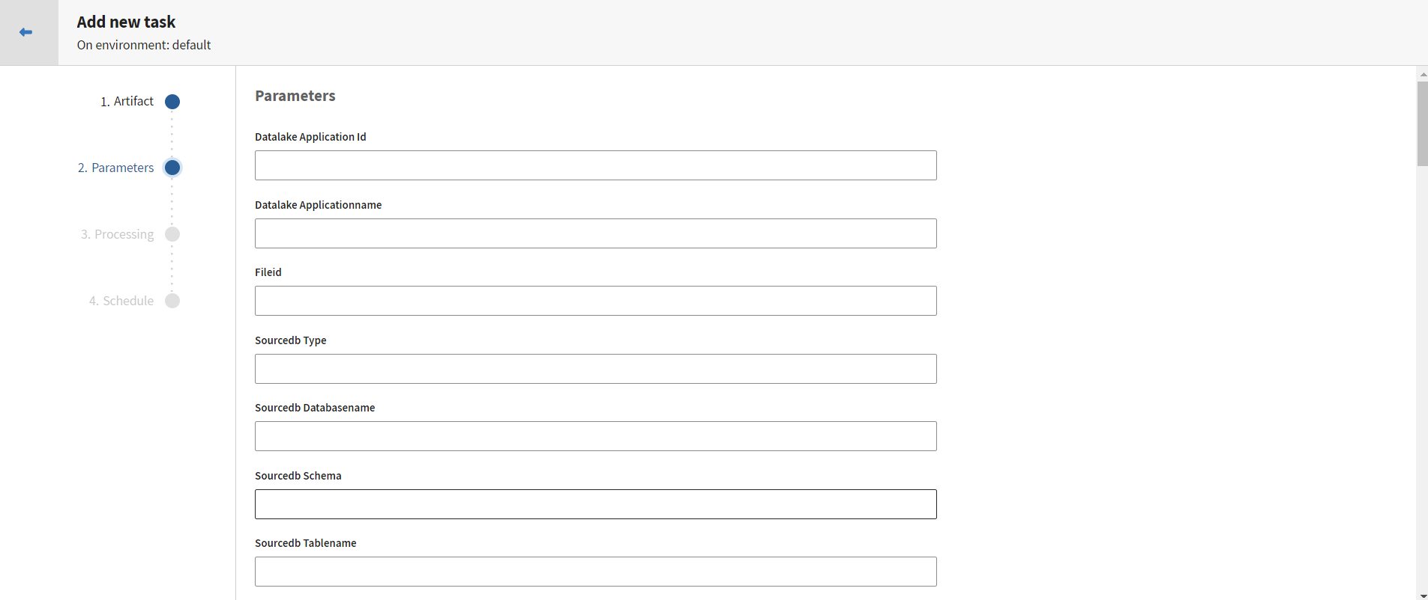
STEP 15 Parameters and click on continue
Talend Tech Solutions

Slide 16
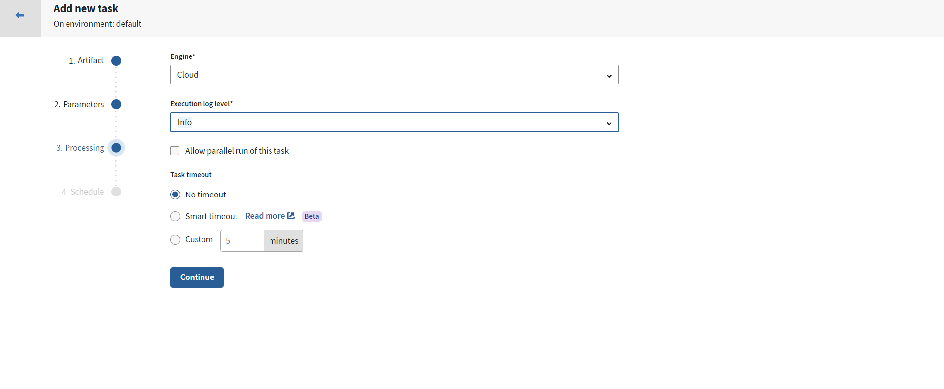
STEP 16 Select engine and continue
Talend Tech Solutions

Slide 17
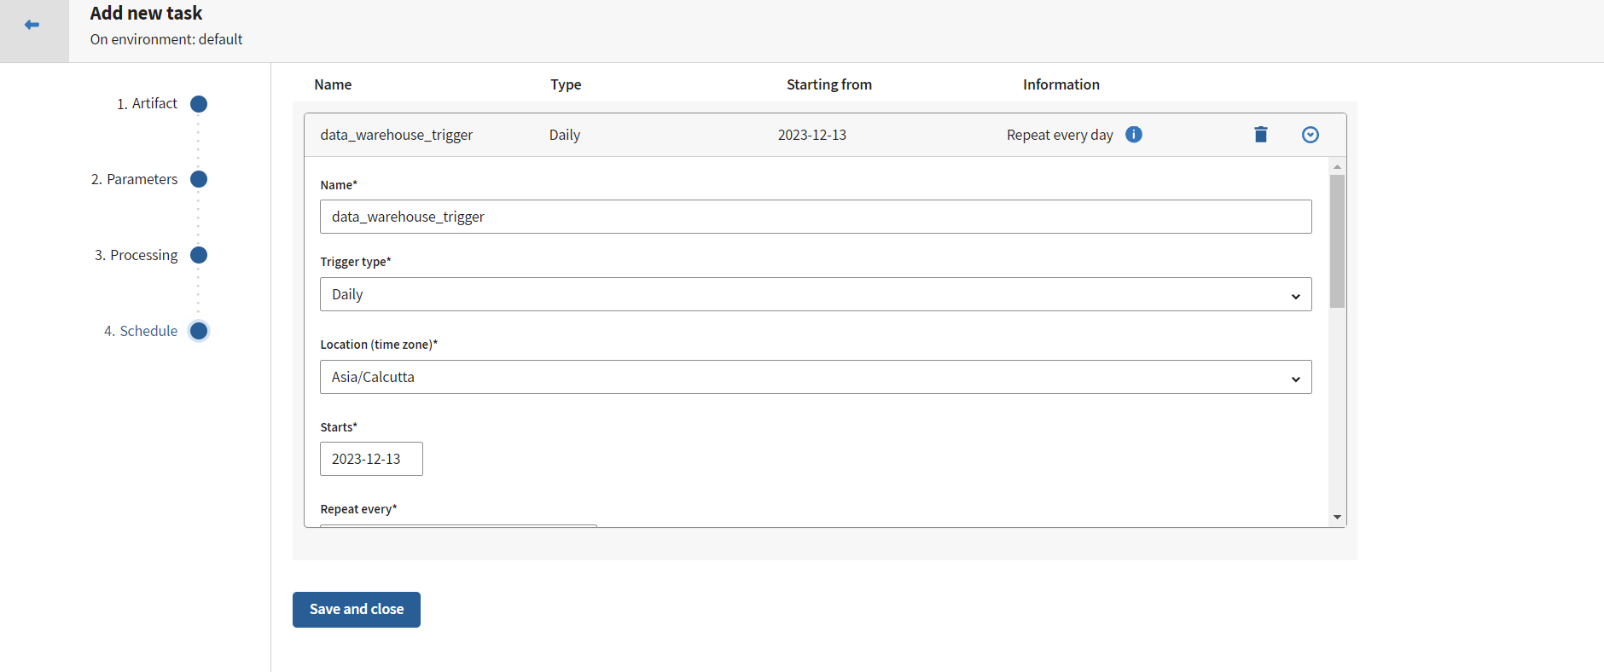
STEP 17 Schedule it and continue
Talend Tech Solutions

Slide 18
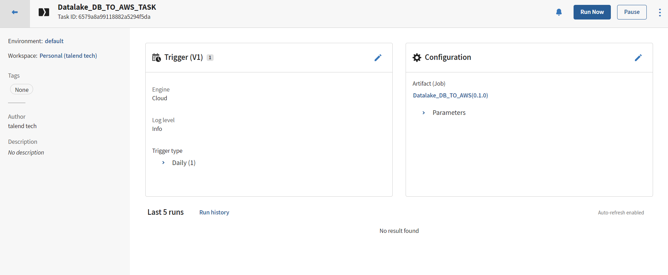
STEP 18 Run
Talend Tech Solutions

Slide 19
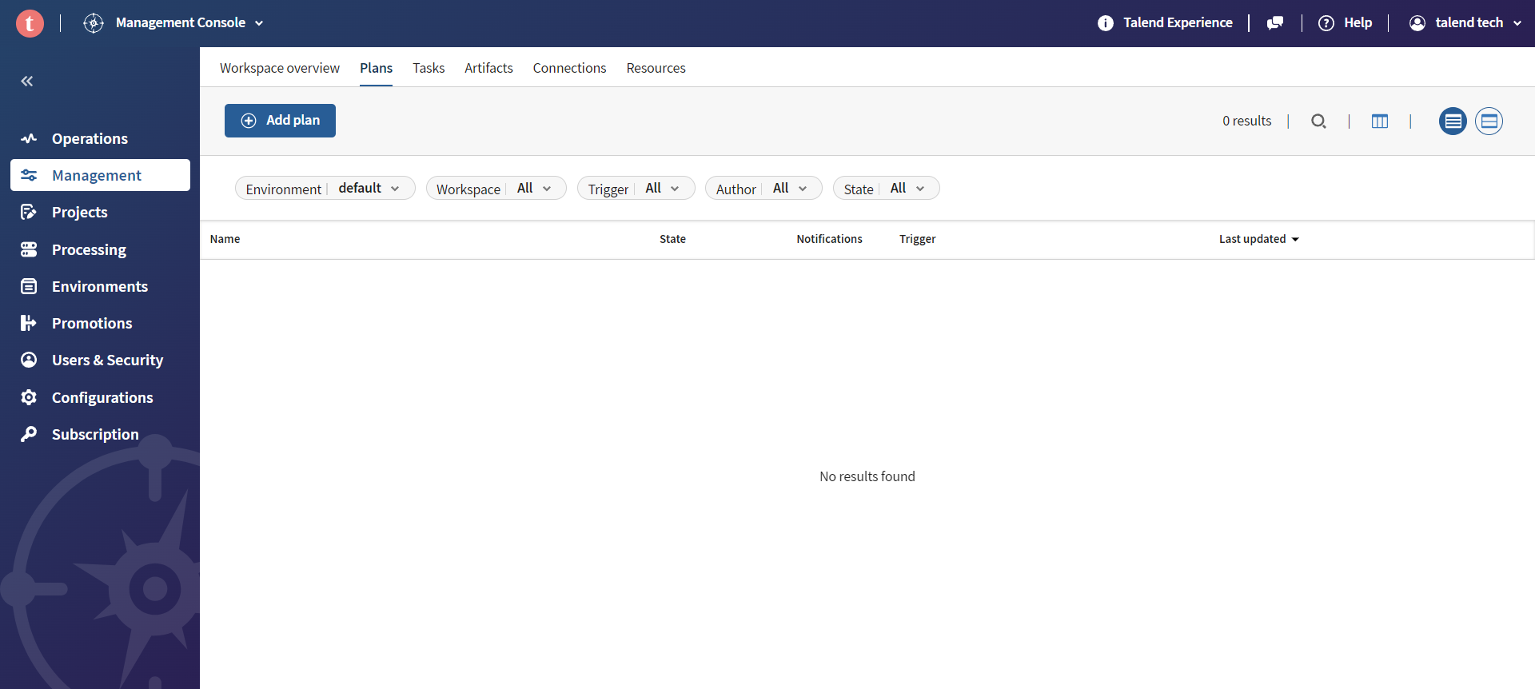
STEP 19 Add plans
Talend Tech Solutions

Slide 20
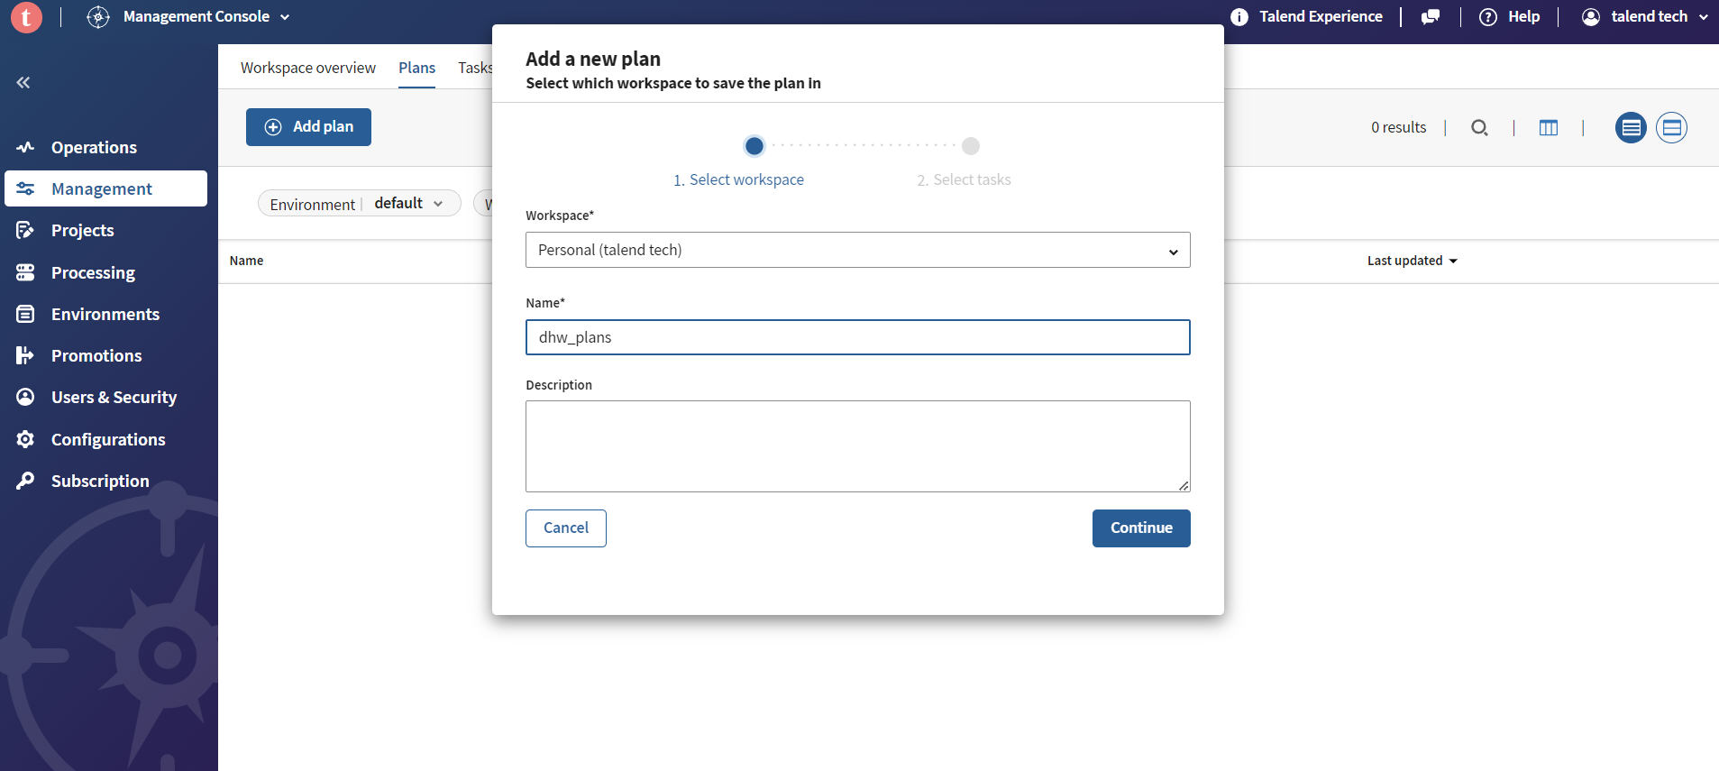
STEP 20 Select workspace and continue
Talend Tech Solutions

Slide 21
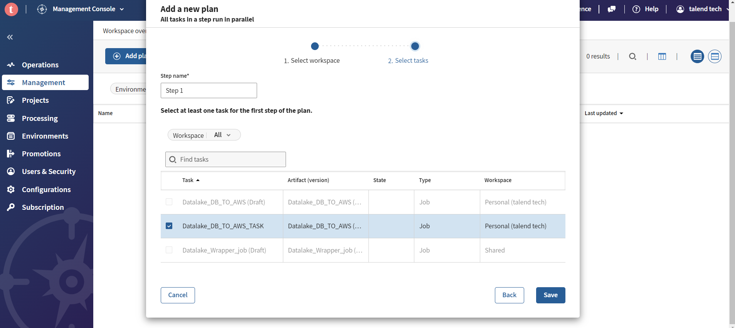
STEP 21 Select task and save
Talend Tech Solutions

Slide 22
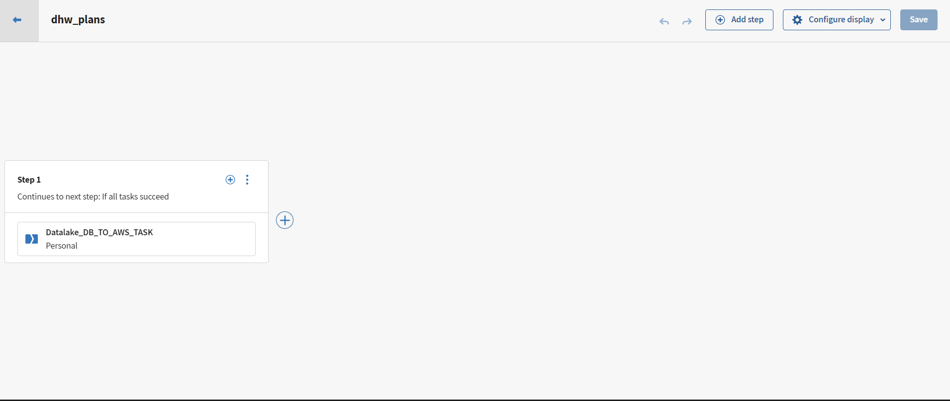
STEP 22 Add steps
Talend Tech Solutions

Slide 23
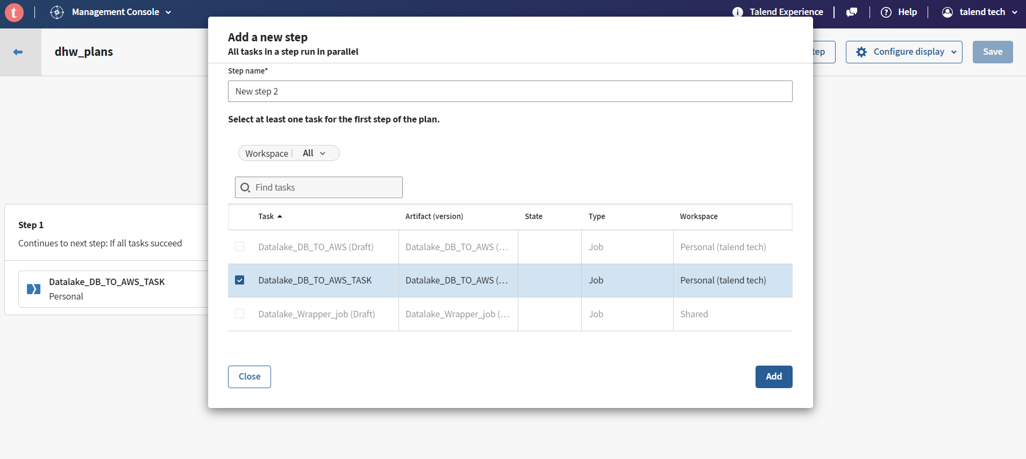
STEP 23 Step2 and add
Talend Tech Solutions

Slide 24
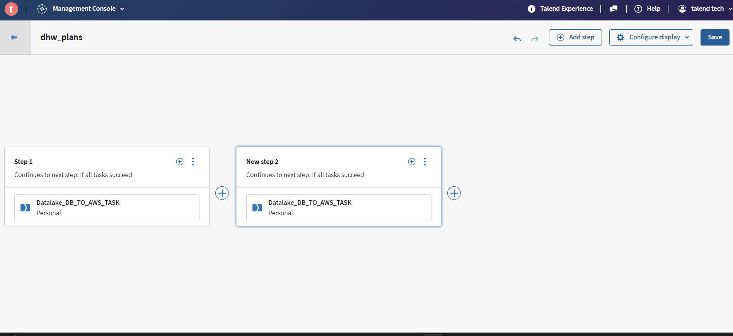
STEP 24 Save
Talend Tech Solutions

Slide 25
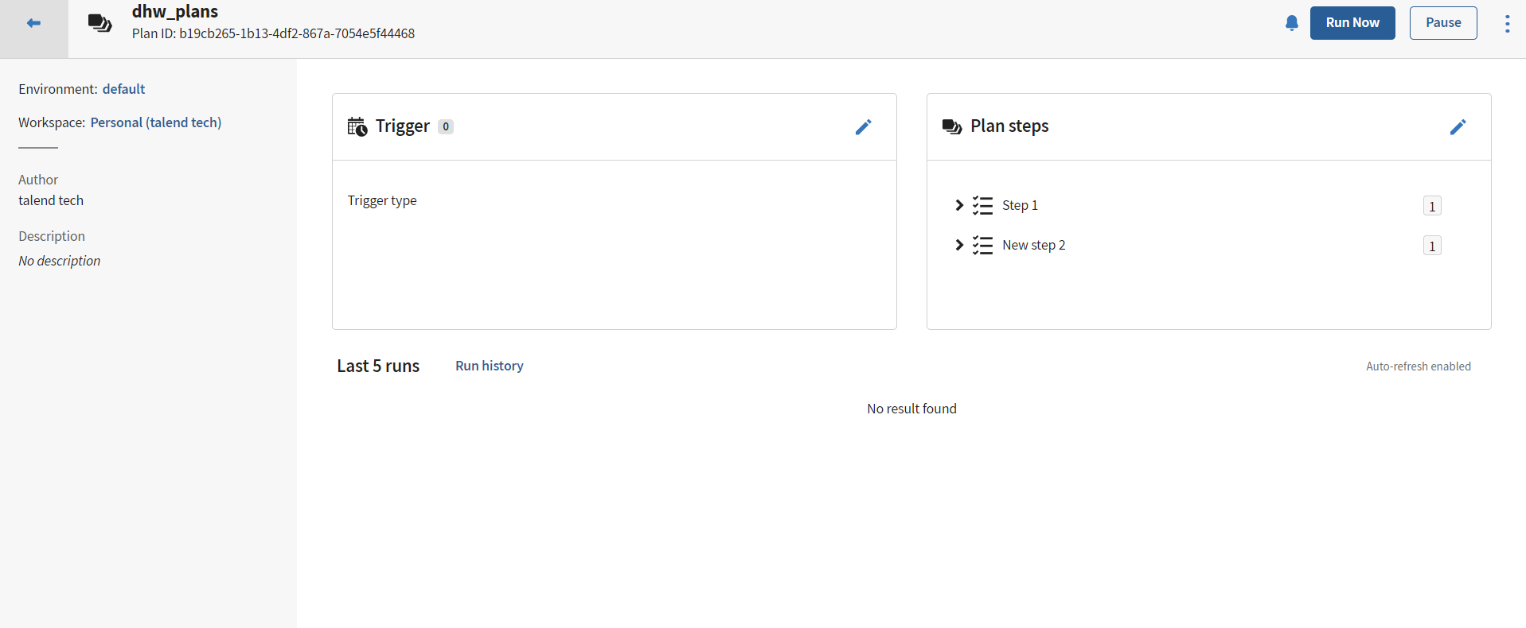
STEP 25 Plans ready to run
Talend Tech Solutions

Slide 26
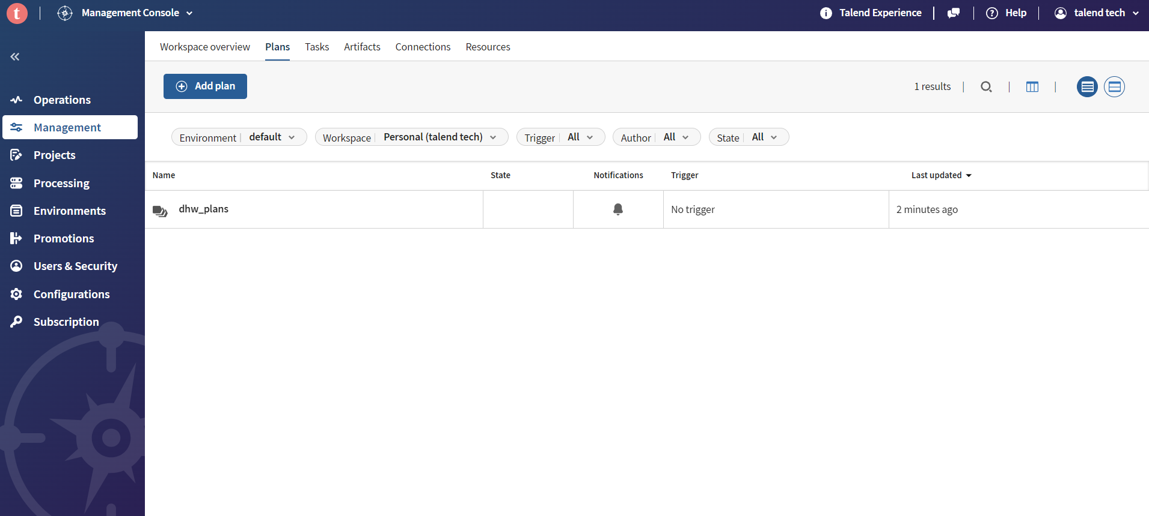
STEP 26 All plans
Talend Tech Solutions

Slide 27
Thank you
Talend Tech Solutions

